Slide 1
Assignment – Logistic Regression
Submitted by: pooran pragnya
November batch (bds)

Slide 2
1. Logistic Regression:
It is a Supervised classification algorithm, that is used where the response variable is categorical.
It is a supervised statistical technique to find the probability of dependent variable (classes present in the variable).
It is similar to linear regression except that how they are used. Linear regression is used for solving regression problems where as logistic regression is used for solving classification problems.
The idea of logistic regression is to find a relationship between features and probability of particular outcome.

Slide 3
Example for logistic regression used in everyday Life:
When we have to predict if a student passes or fails in an exam when the number of hours spent studying is given as a feature, the response variable has two values.
This type of problem is referred as Binomial logistic regression, where the response variable has two values 0 and 1 or Pass and Fail or True and False. Multinomial logistic regression deals with situations where the response variables can have three or more possible values.

Slide 4
Function Used in Logistic Regression:
The function used in logistic regression is “S” shaped function called as Sigmoid Function.
Sigmoid function tries to convert the independent variable into a expression of probability i.e numerical value that ranges between 0 and 1with respect to dependent variable.
In logistic regression, instead of fitting a regression line, we fit an “s” shaped logistic function, which predicts the value ranging between 0 and1.
The curve from a logistic regression indicates likelihood of something such as whether the cells are cancerous or not, a mouse is obese or not based on its weight etc.

Slide 5
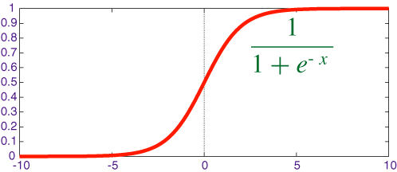
Where,
0 indicates that there is no probability of occurrence of an event.
1 indicates that there is certain probability of occurrence.
0.5 it is very rare and unclassified, generally not happens in LR.

Slide 6

Sigmoid Function:
It is given by the formula:
Where,
Y = Dependent Variable
e = Natural Logarithm base or also known as Euler’s Number. Its Value is 2.718.
X= independent Variable (That has to be transformed into probability)
Y = $\frac{1}{1+e−x}$

Slide 7
Applications of Logistic Regression:
It is used in fraud detection.
It finds the application in disease diagnosis.
It is applied in Credit Scoring in financial company.
It is used to detect whether the email is spam or not.
It is used in text editing, hotel booking etc.

